Slide 1
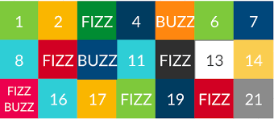
Fizz BuZZ
Program that loops through the numbers 1 to 100. For multiples of 3, print "Fizz" instead of the number, for multiples of 5, print "Buzz", and for multiples of both 3 and 5, print "FizzBuzz“.

Slide 2
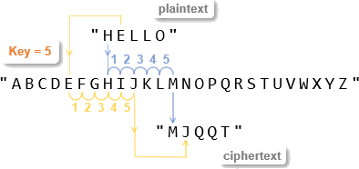
Caesar Cipher

Slide 3
Write an Encryptor.
Write an Decoder.
vspo sc dyy crybd dy lo cobsyec kvv dro dswo
cy sp iye mkxd vkeqr kd iyebcovp mkvv wo S vv vkeqr kd iye
Jul jnf gur zngu obbx fnq? Orpnhfr vg unq gbb znal ceboyrzf
RULES
Key will be positive / forward moving.
Can only have lower case letters.
No Numbers.
No Special Characters or any other stuff except lower case letters.

Slide 4
life is too short to be serious all the time. so if you cant laugh at yourself call me I ll laugh at you
Why was the math book sad? Because it had too many problems

